Slide 1


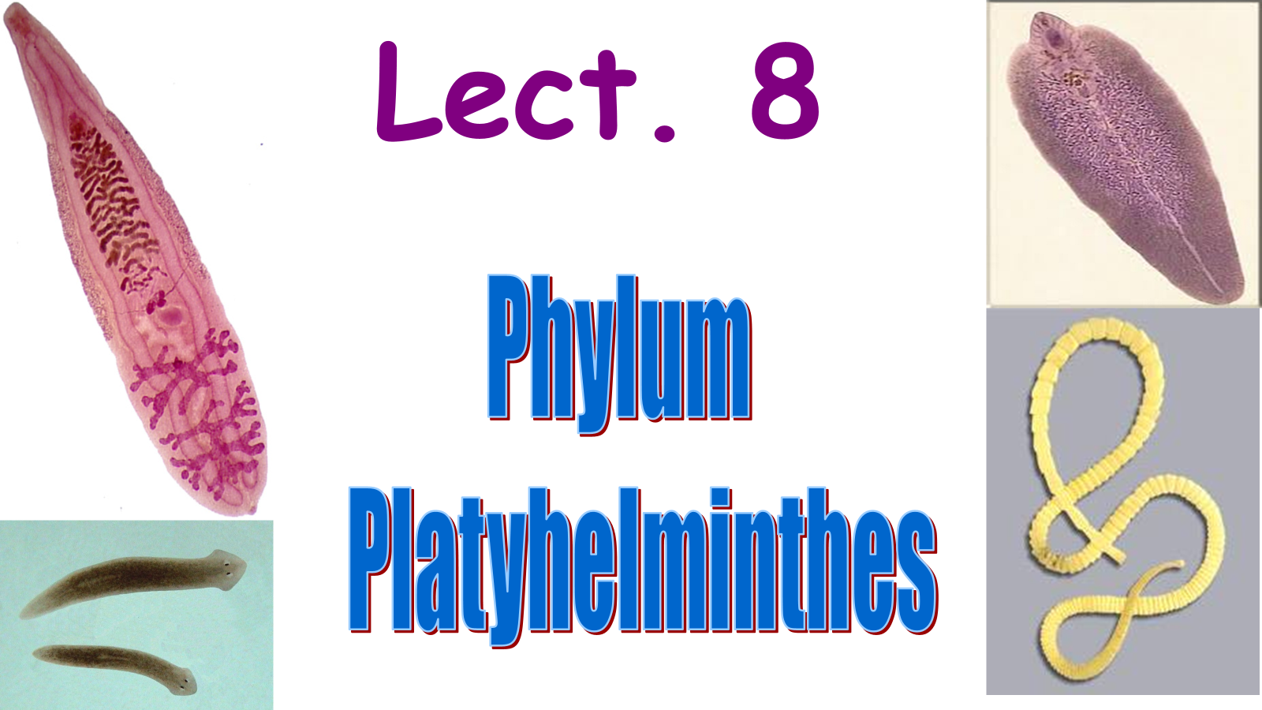
BASRAH UNIVERSITY
Faculty of Education for Pure Sciences
Biology Department
2025- 2026
Presented By: Prof. Dr. Sabeeh H. AL-Mayah

Slide 2
Class: Trematoda, Subclass: Digenea
Parasitic lifestyle with two hosts.
First intermediate host is a mollusks.
Second definitive host is a vertebrate.
Sexual reproduction occurs in the definitive host.
Occasionally a third host (intermediate) plays a role in the life cycle.
Parasitism can occur in almost every system of the body including the digestive, respiratory, circulatory, excretory, and reproductive systems.
Adult forms are all endoparasites in a wide variety of vertebrates that serve as definitive hosts. The one or more intermediate hosts (the hosts that harbour immature stages) may harbour several different larval stages .
Examples: Fasciola, Clonorchis, Schistosoma.

Slide 3
Class Trematoda (Flukes) subclass : Digenea
The body wall is adapted for parasitic way of life
The epidermis consists of an outer layer called tegument, which forms a syncytium (a continuous layer of fused cells)
The outer zone of the tegument consists of organic layer of proteins and carbohydrates called the glycocalyx. The glycocalyx aids in the transport of nutrients, wastes, and gases across the body wall, and protects the fluke against enzymes and the host's immune system
Also found in the epidermis are the microvilli that facilitate nutrient exchange.
There are two large suckers. The anterior sucker is the oral sucker and surrounds the mouth. The other sucker, the acetabulum, is located ventrally on the middle portion of the body.

Slide 4
Parasitic Flukes in Humans
Some of the most serious parasites in humans are flukes.
Schistosoma is a blood fluke that causes a serious infection called schistosomiasis. Schistosomiasis is one of the deadliest diseases in the world.
There is estimated to be about 200 million people infected with schistosomiasis in Africa, South America, and the Middle East.
Symptoms of schistosomiasis include dysentery, anemia, enlarged liver, bladder inflammation and brain damage.
Fasciola hepatica ,F.gigantica

Slide 5
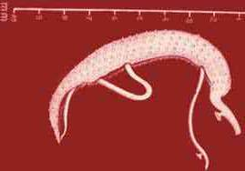
Blood flukes
Schistosomiasis is a parasitic disease caused by several species of fluke of the genus Schistosoma.
Species of Schistosoma that can infect humans:
Schistosoma mansoni cause intestinal schistosomiasis
Schistosoma haematobium causes urinary schistosomiasis
Schistosoma japonicum cause Asian intestinal schistosomiasis
The nearly-mature worms' pair, with the longer female worm residing in the gynaecophoric channel of the shorter male

Slide 6
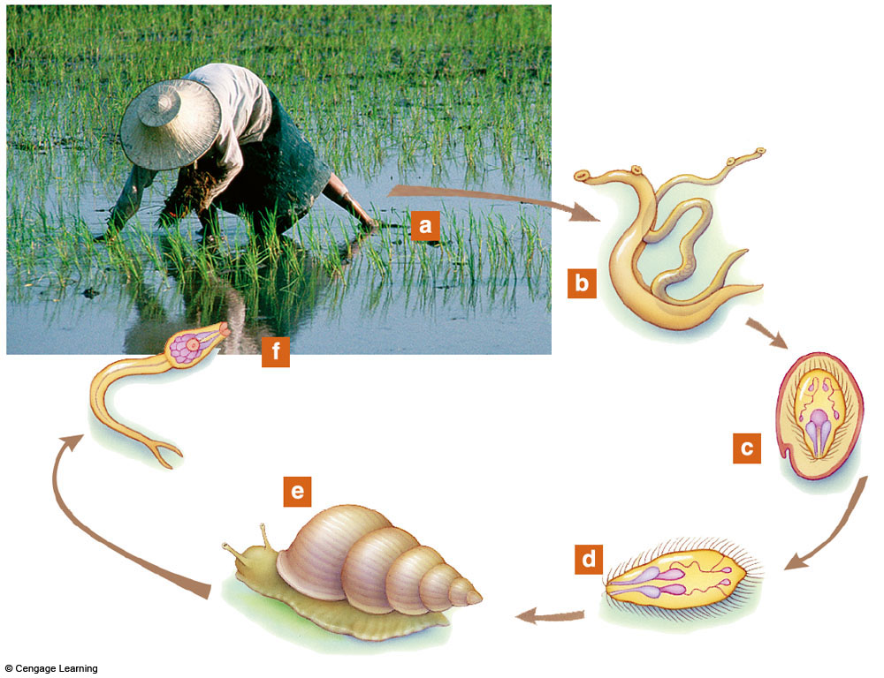
Parasite Life Cycle: Blood Fluke

Slide 7
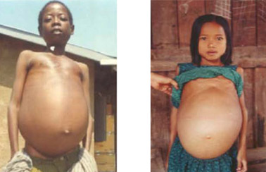
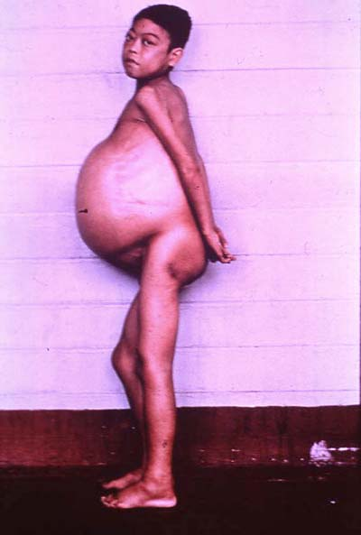
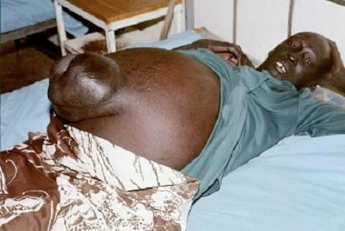
Intestinal
Schistosomiasis
16 yr. Old boy
Abdomen accumulates fluid-
a body immune response to
eggs embedded in tissues

Slide 8

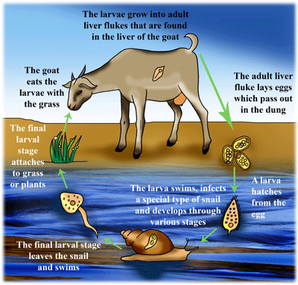
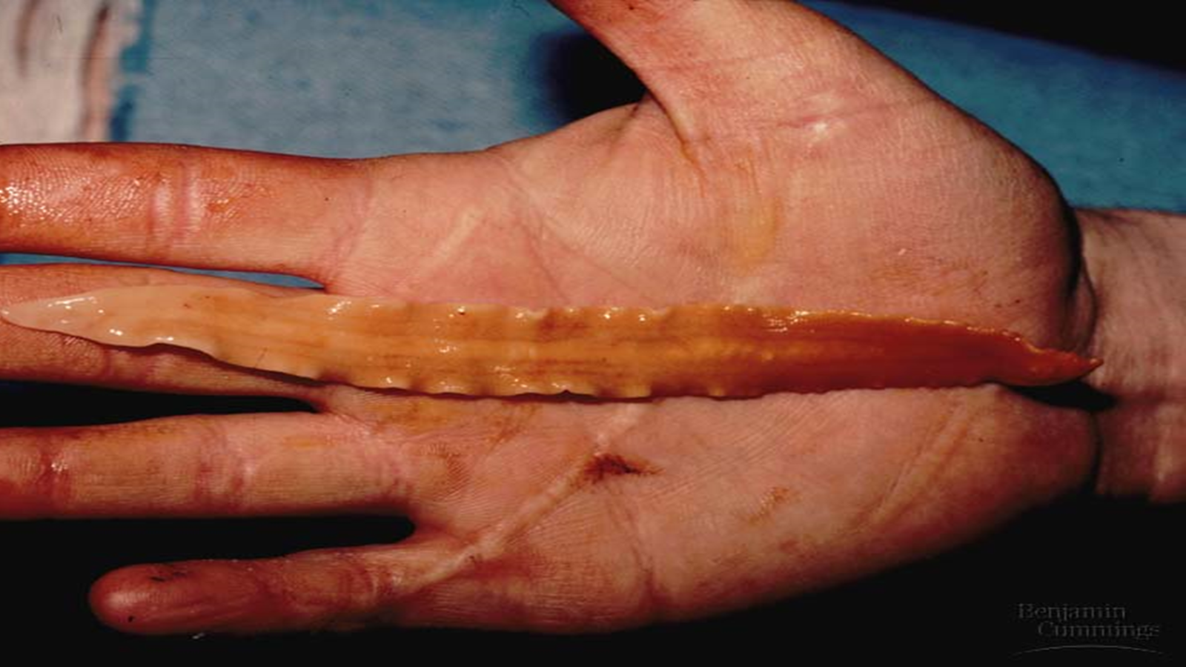
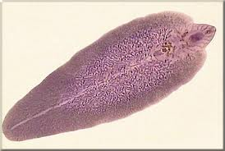
Fascioliasis Fasciola hepatica; F.gigantica

Slide 9
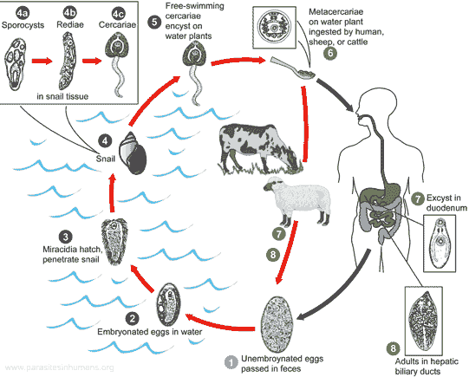

Slide 10
Class Cestoda (The tapeworms)
This class consists of most highly specialized flatworms. Members are commonly called tapeworms or cestodes. All are endoparasites that usually reside in the vertebrate digestive system. Adult tapeworms range from 1 mm to 25 m in length
Two unique adaptations to a parasitic lifestyle characterize tapeworms:
Tapeworms lack a mouth and digestive tract in all of their life-cycle stages; they absorb nutrients directly across their body wall.
2-Most adult tapeworms consist of a long series of repeating units called proglottids. Each proglottid contains a complete set of reproductive structures.
Class Cestodes has two subclasses:
Subclass Cestodaria
Members of this subclass are all endoparasites in the intestine and coelom of primitive fishes. They possess some digenetic trematode features in that only one set of both reproductive systems is present in each animal, some bear suckers, and their bodies are not divided into proglottids like other cestodes.

Slide 11
Class Cestoda (The tapeworms)
Subclass Eucestoda
Almost all the cestodes belong to the subclass Eucestoda and are called true tapeworms.
They represent the ultimate degree of specialization of any parasitic animal.
At one end is a hold-fast structure called the scolex that contains circular or leaflike suckers and sometimes a rostellum of hooks. The scolex helps to anchor the tapeworm firmly to the intestinal wall of its definitive vertebrate host.
No mouth is present. Posteriorly, the scolex narrows to form the neck. Transverse constrictions in the neck give rise to strobila (pl., strobilae). The strobila consists of a series of linearly arranged proglottids, which function primarily as reproductive units.
As the tapeworm grows, new proglottids are added in the neck region, and older proglottids are gradually pushed posteriorly. As they move posteriorly, proglottids mature and begin producing eggs.

Slide 12
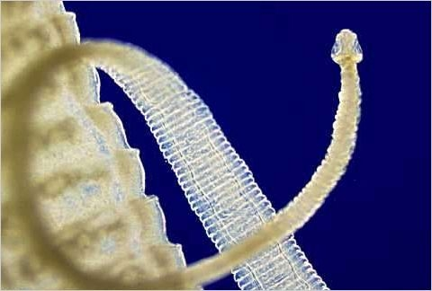
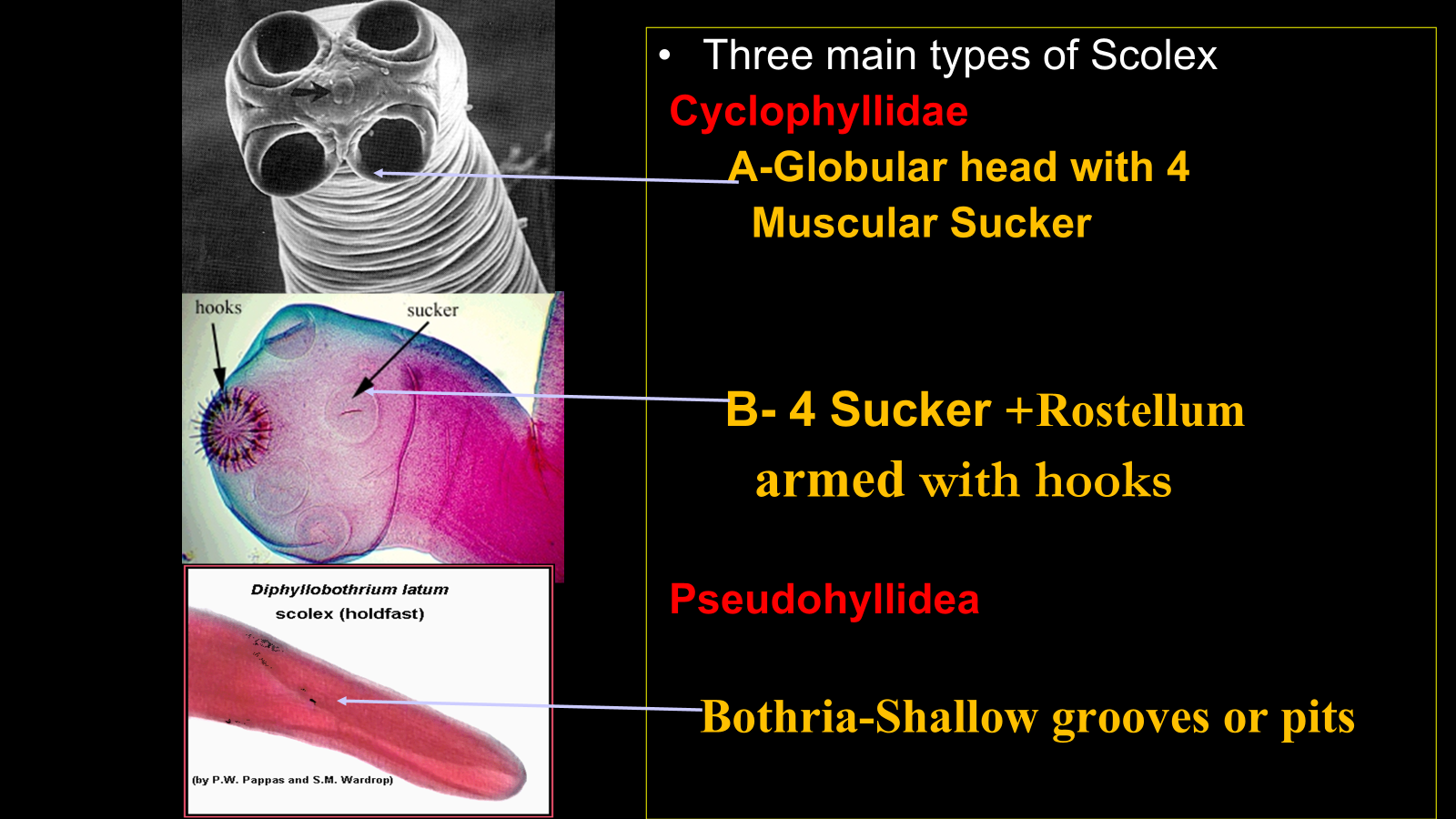
Tapeworm

Slide 13
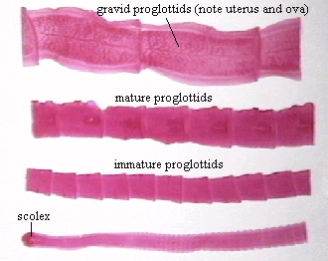
Strobila is divided into three regions:
a/ Immature segment:
near neck, sex organs are immature.
b/ mature segment:
large segment, sex organs are fully mature.
c/ gravid segment:
found at the tail end, uterus is filled with eggs

Slide 14
Class Cestoda (The tapeworms)
Tapeworms are monoecious, and most of their physiology is devoted to producing large number of eggs. Each proglottid contains a complete set of male and female reproductive organs.
Numerous testes are scattered throughout the proglottid and deliver sperm via duct system to a copulatory organ called cirrus.
The male system of a proglottid matures before the female system, so that copulation usually occurs with another tapeworm in the same host.
A single pair of ovaries in each proglottid produces eggs. Sperms stored in a seminal receptacle fertilize eggs as the eggs move through the oviduct. Most tapeworms have a blind ending uterus, where eggs accumulate.
Eggs are released when gravid proglottids break free from the end of the tapeworm and pass from the host with the host’s feces. Because proglottids are not continuously lost, adult tapeworms usually become very long.

Slide 15
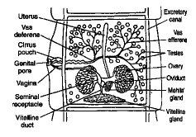
RED = Male Black = Female

Slide 16
Classification
Order Cyclophllidea
T. saginata
T. solium
Hymenolepis spp.
Echinococcus granulosus
Order Pseudopyllidea
Diphyllobothrium latum

Slide 17
Taenia species
Geographical Distribution:-
T. saginata
Worldwide distribution where cattle are raised, and beef is eaten raw or under cooked.
T. solium
Not widely distributed as T. saginata.
Common in all areas where raw or partially cooked pork is eaten.
Common throughout Mexico, South America and southern Africa & southern Europe.

Slide 18
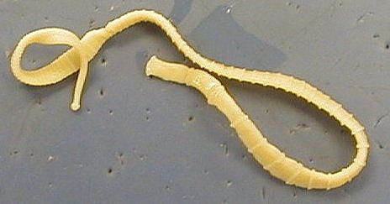
Morphology:
T. saginata
T. solium
Adult
Size: 2-3m
Color: pale blue
Strobila: 800-1000 Proglottids
Mature segment :0.5-1.5 cm
Adult:
Size: 4-10 m long (can reach up to 20 m)
Color: ivory white
Strobila : 1000-2000 proglottids
Mature segment: 1-2cm long

Slide 19
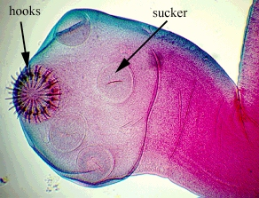
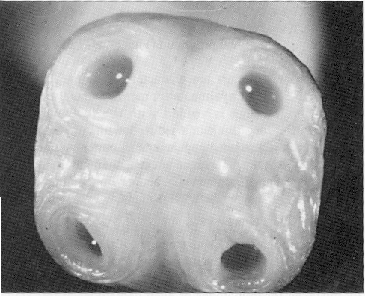
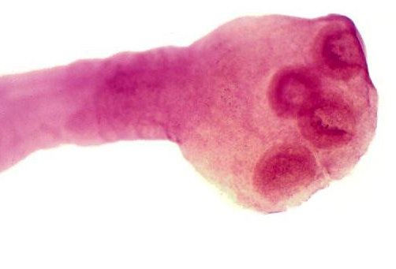
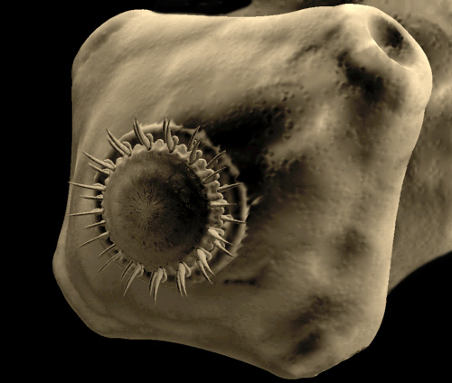
Taenia saginata
Scolex (head):
Quadrate, with four suckers, no hooks, no rostellum on scolex
Size-2mm across
T. solium
Scolex has
Four sucker
two rows of hooks on a prominent rostellum
Size-1mm

Slide 20
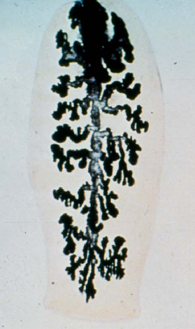
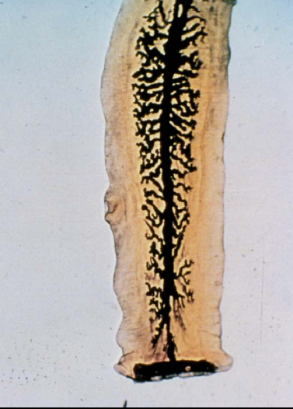
Taenia saginata
T. solium
Gravid proglottide
Detach when fully develop and pass through the anus independently.
Color- white and opaque
Size- 20mmX6mm
Uterus- > 13 main (15-30) lateral uterine branches.
Gravid proglottids-
Grey-blue and translucent
Size-13mmX8m
7 to 12, on average 10 lateral compound uterine branches.
Small chains of 3-4 rectangular segments found in the feaces

Slide 21
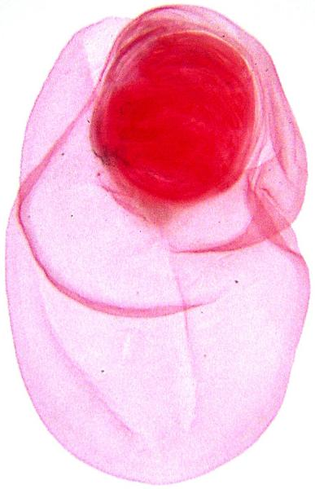
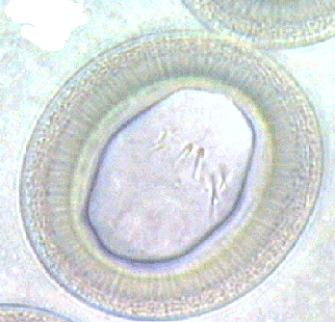
Taenia sp.
Larval stage is Cysticercus
Invaginated scolex in fluid filled body
Cysticercus bovis- T. saginata
Cysticercus cellulosae- T. solium
Eggs are very round with very thick walls.
T. solium
Distinct difference with T. saginata is that humans can be infected with egg stage and oncosphere migrates to some site in body and develops into Cysticercus
This can be serious, called Cysticercosis

Slide 22
Transmission and life cycle
Transmission
Humans become infected by ingesting raw or undercooked meat infected with Cysticercus larvae:
Beef- T. saginata
pork meat –T.solium
T. solium can also be transmitted by :
Ingesting ova in food or water
Internal autoinfection

Slide 23
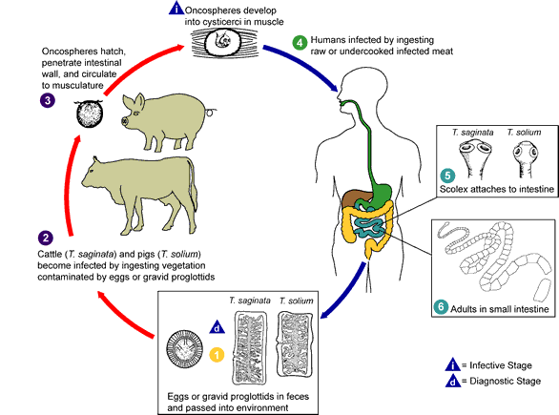

Slide 24
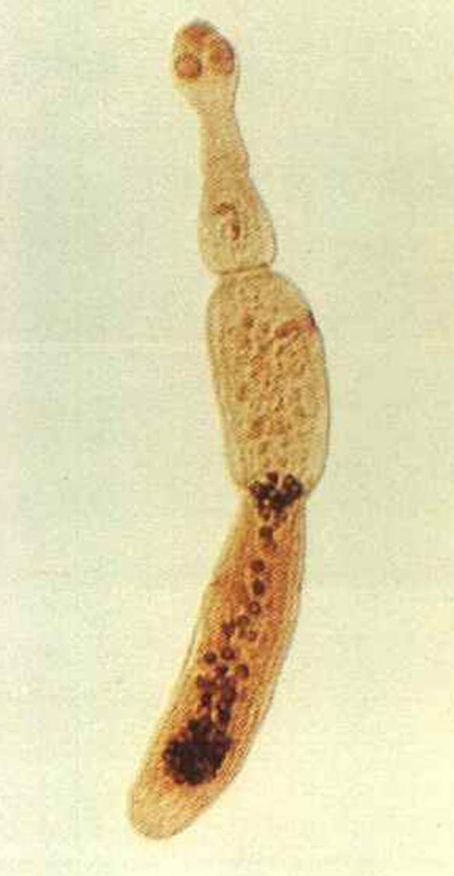
Echinococcus granulosus
Sheep Tapeworm
Definitive Host: Carnivores including dogs, wolves, and coyotes
Intermediate Host: Herbivores including sheep and mice.
Occasionally infect humans.
The hydatid cysts growing humans very slowly and can overcrowd organs.
Geographic Distribution: Most common in sheep raising countries
New Zealand and Australia highest incidence
Notes:
Smallest adult forms the biggest larvae.
There may be different strains involved that use wolf-moose, wolf-reindeer, dingo-wallaby, lion-warthog. For humans, the most important is dog-sheep. The strains differ morphologically, development, metabolism, DNA, and host specificity. Worms of one strain do not develop well in other species. Can be important in human infections. In Europe, the strain common in horse and pigs do not infect humans but the strain in sheep and cattle does.

Slide 25
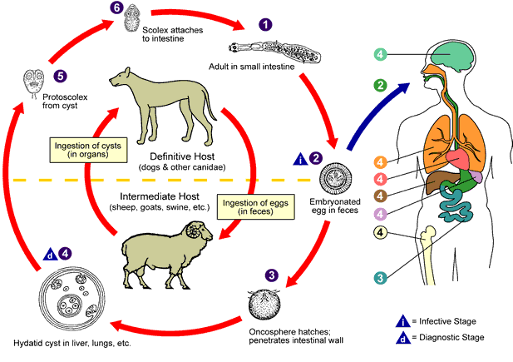

Slide 26
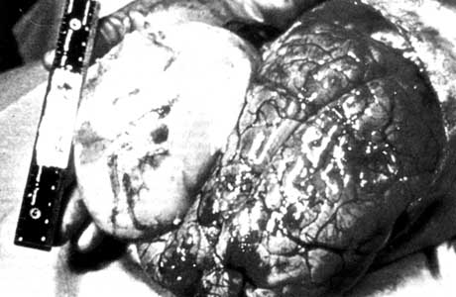
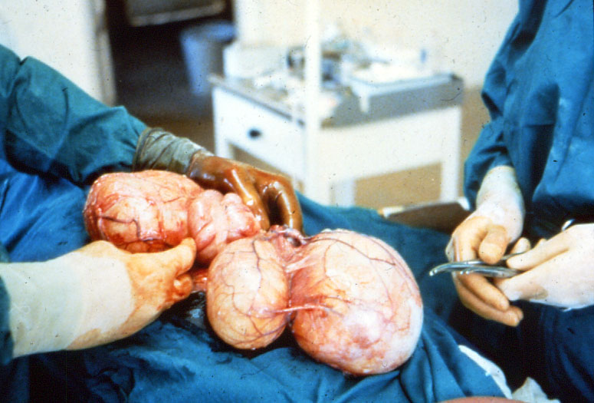
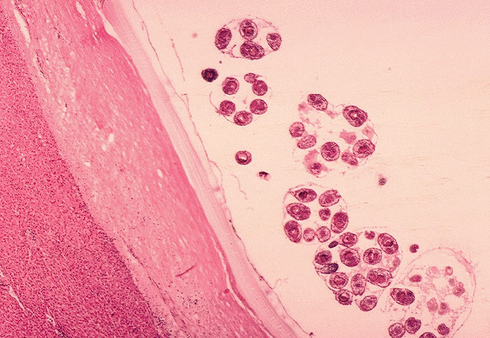
E. granulosus hydatid cyst

Slide 27
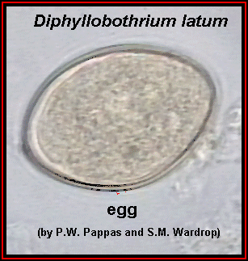
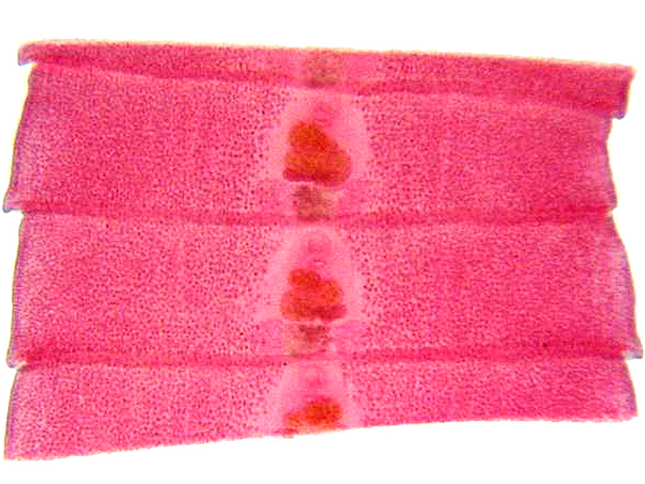
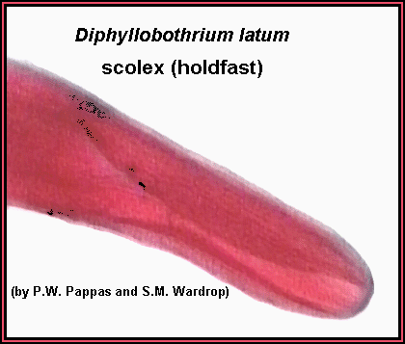
Diphyllobothrium latum Common name: Fish tapeworm
Geographical Distribution:-
Widely distributed in the lake areas of Europe, Asia, Far East, North America, South America and Central Africa .
Important parasite of man.
Definitive hosts can be humans, dogs, foxes, cats, mink, bears, and seals.
Site of attachment : small intestine.

Slide 28
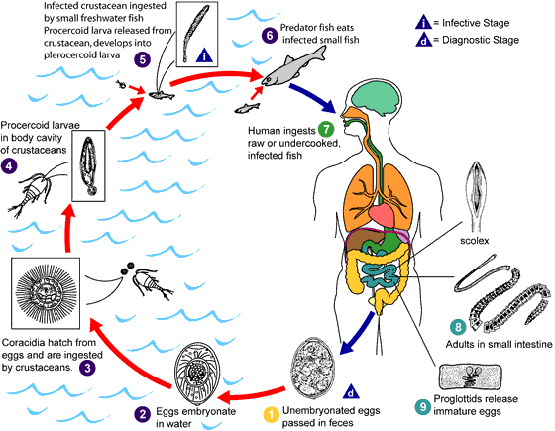

Slide 29
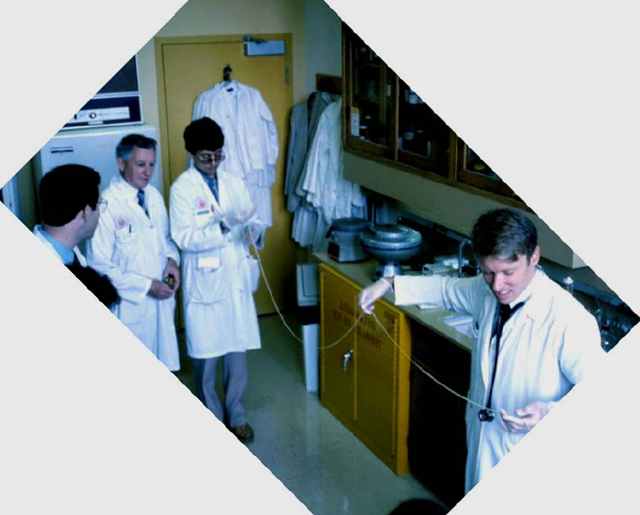

Slide 30
Thank You!

